Slide 1
DEPARTMENT OF INFORMATION SCIENCE & ENGINEERING
MC&ES PROJECT PRESENTATION
Title: Regulator for Public Toilets
Presented by - 1.Yashwanth R (1DT21IS173)
2. Subramanya (1DT21IS149)
3. Uday Kiran (1DT21IS124)
Coordinator – Mrs.Nikshepa T
Assistant Professor

Slide 2
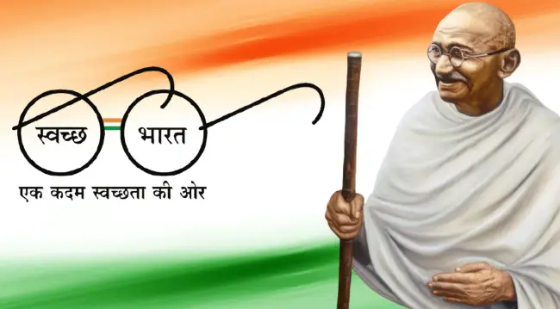
SWACHH BHARAT ABHIYAN
On October 1, 2021, Prime Minister Narendra Modi had launched the second phase of the Swachh Bharat Mission (Urban), which envisions making all cities in the country "garbage-free".
Govt announced a 150-per cent hike in the outlay of its flagship scheme with an allocation of Rs 5,000 crore in the Union Budget 2023-24.

Slide 3
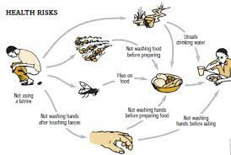
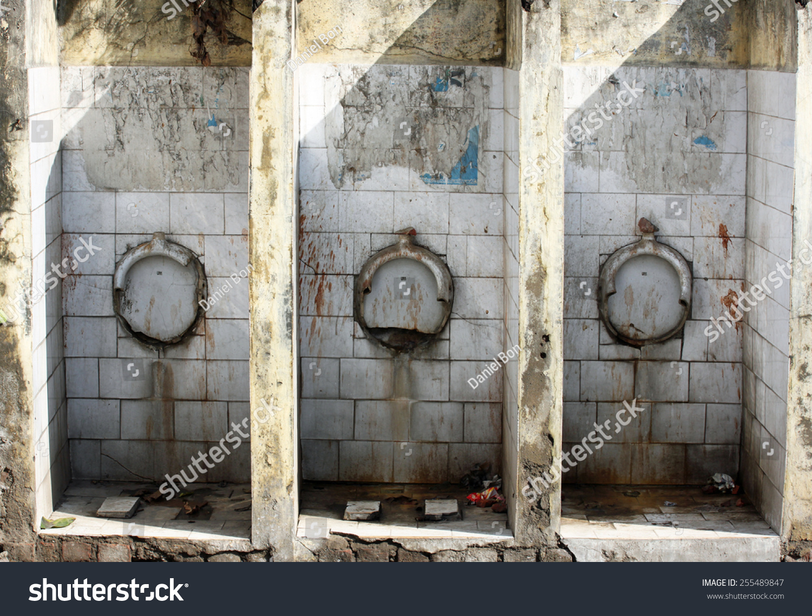
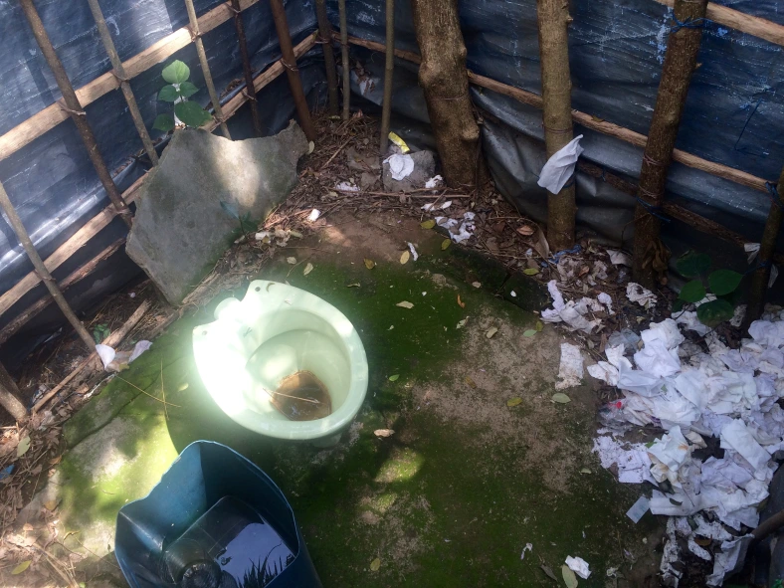
INTRODUCTION:
BASIC HYGIENE REGULATOR FOR
PUBLIC TOILETS:
Now a days it can easily observed that public toilets are getting worse day by day. But what’s making them so bad is the bad hygiene maintenance. This leads to many diseases to spread .The main reason for the dirty toilets are people who use it wont flush after using .

Slide 4
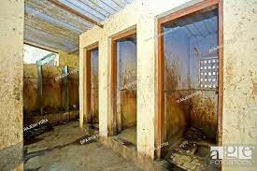
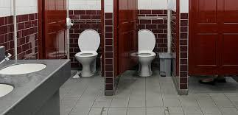

TOILETS AND HYGIENE:
Toilet hygiene is of the utmost importance. Disease prevention becomes increasingly essential if certain affected individuals are living in the same environment as well.
A lot of people use public toilet a day and the installing of more number of public toilets is of utmost important and at the same time its maintenance is also most important.

Slide 5
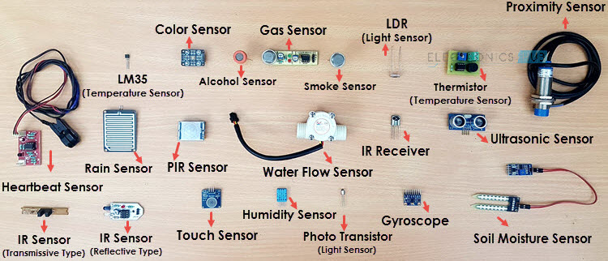
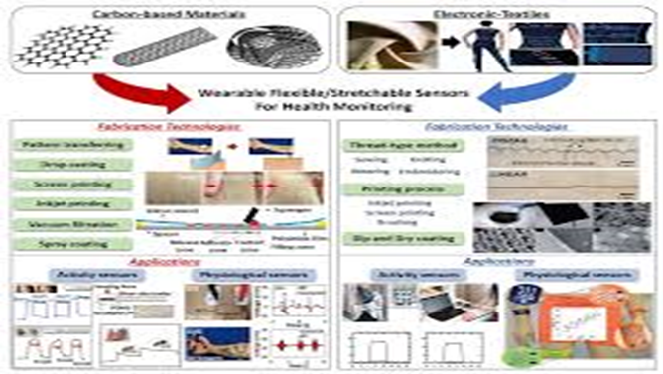
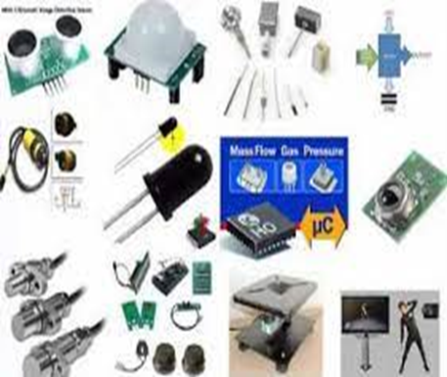
COMPONENTS USED: a.SENSORS:
Sensor as an input device which provides an output (signal) with respect to a specific physical quantity (input).
It is a device that converts signals from one energy domain to electrical domain.

Slide 6
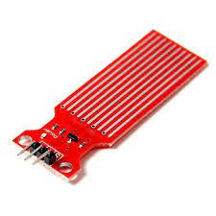
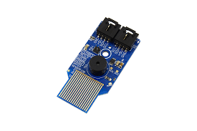
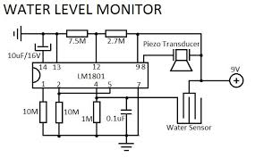
a.1.WATER SENSORS:
A water sensor is a device used in the detection of the water level for various applications. Water sensors can come in several variations that include ultrasonic sensors, pressure transducers, bubblers, and float sensors.
Working Method :
Ultrasonic sensors operate by transmitting sound waves that reflect from the liquid surface and are obtained by the sensor. The sensor measures the time interval between the transmitted and received signals, which is then converted into distance measurement with the help of electronic circuits within the sensor thereby measuring the level of the liquid.

Slide 7
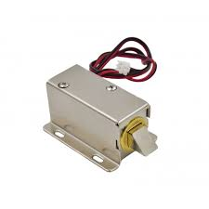
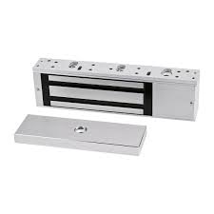
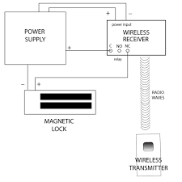
b. ELECTROMAGNETIC LOCK:
An electromagnetic lock, magnetic lock, or maglock is a locking device that consists of an electromagnet and an armature plate.
Principle:
The principle behind an electromagnetic lock is the use of electromagnetism to lock a door when energized.
The holding force should be collinear with the load, and the lock and armature plate should be face-to-face to achieve optimal operation.

Slide 8
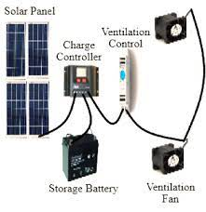
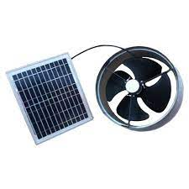
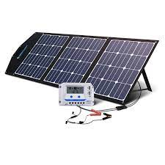
c. SOLAR PANELS: c.1. FOR CONTROLLING OF EXHAUST FANS:
By connecting the exhaust fans to the solar instead of using electrical lines we can save the energy and can thus can also assure the fresh air inside the toilets.

Slide 9
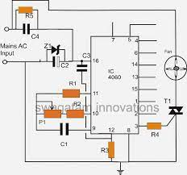
C.2.SOLAR FOR SUPPLY OF ELECTRICITY:
Using solar panels light energy can be converted into electrical energy which can be stored and this can be used as a source to provide electricity by this we can save energy and also this achieves green technology.

Slide 10
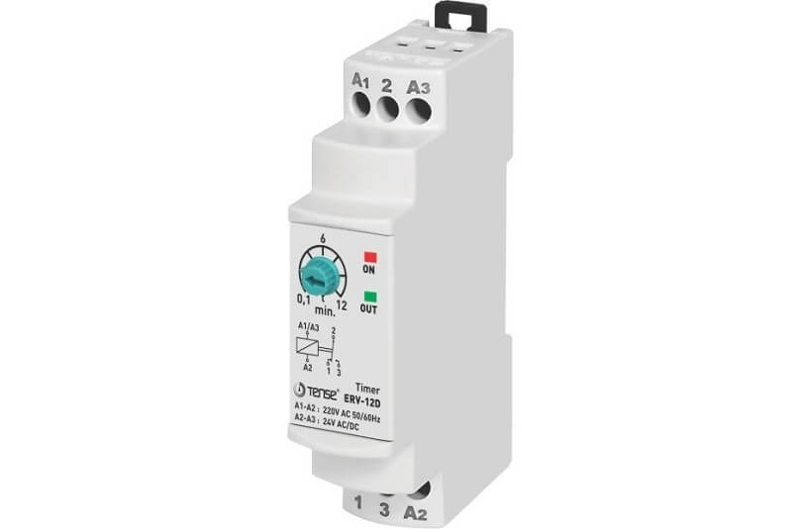
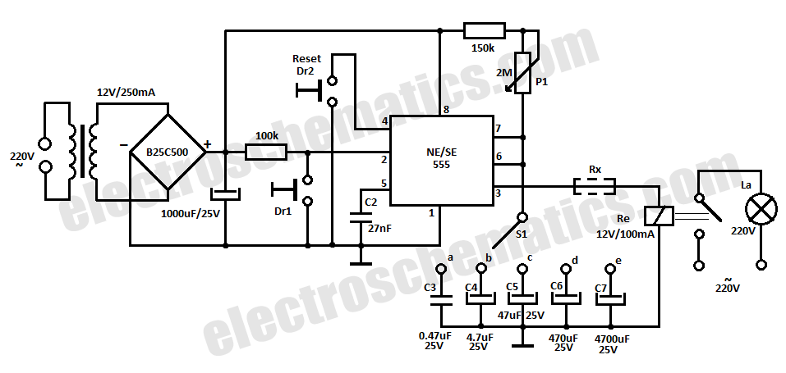
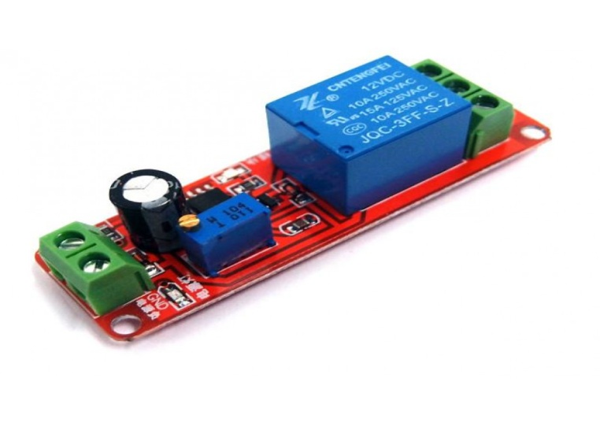
d. RELAYS:
A timer relay, following the energization of its coil, changes the status of its contacts cyclically. Usually, the time period during which the contacts could remain closed or open is externally adjustable, and the cycling period can vary from some milliseconds to several hundred hours.

Slide 11
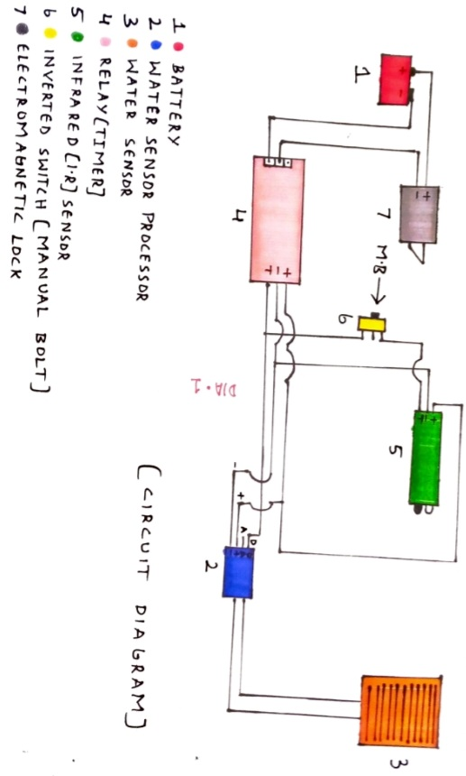
CIRCUIT DIAGRAM OF TOILET RGULATOR:

Slide 12
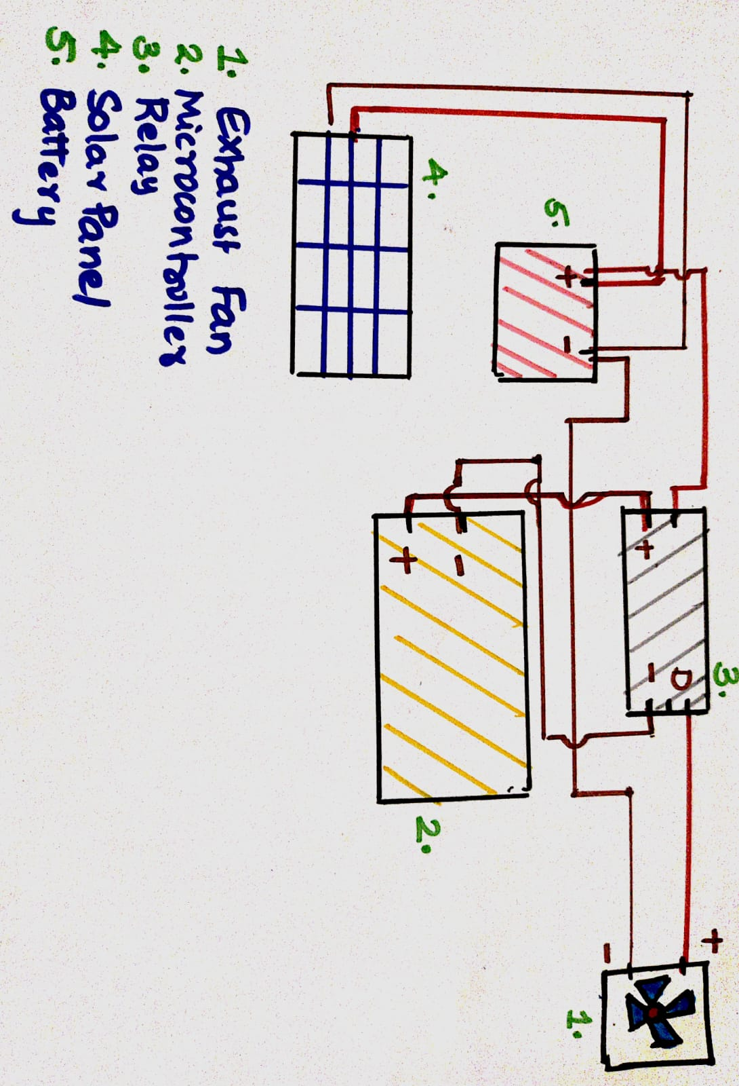
CIRCUIT DIAGRAM FOR EXHAUST FAN:

Slide 13
BENEFITS: .Since solar technology is involved we can save energy. . This leads to clean and healthy environment. . This ensures hygiene and prevent many diseases from spreading.

Slide 14
CONCLUSION:
Proposal of this project is to increase the hygiene rate of any public toilets drastically.
It will prevent origination of diseases from public toilets.
By preventing origination, spreading of diseases will be automatically prevented.
People remain healthy and will also develop a tendency to put water in any public toilets they visit.

Slide 15
FUTURE PLAN :
To make the results more precise and to improve this project ,future plan is to implement the innovation/project in few public toilets and test how they work and how people respond to it.
Also, aim to make this project widely usable at numerous public places like hotels, hospitals, schools and colleges in future.
With the proper funding this project can be modified into proper infrastructure, which can be implemented in such way that it can be applied all over without any damage to the equipments.

Slide 16
REFERENCES
https://www.electronicshub.org/what-is-relay-and-how-it-works/
http://www.electricalterminology.com/time-relay/
https://www.wikipedia.org/
THANK YOU

